Slide 1

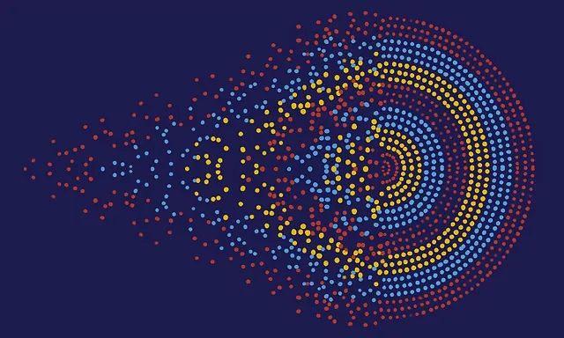
COSC41000 Deep Learning for Sequential Analysis Fall 2024
Dr. Priyamvada (Pia) Tripathi
Introduction to deep learning

Slide 2
Course Overview
Introduction to Deep Learning:
Basic Concepts: discussing neurons, layers (input, hidden, output), and how data flows through these layers.
Mathematical Foundation: The core mathematical concepts, including activation functions, weights, biases, and how a neural network learns using backpropagation and gradient descent.
Understanding Sequential Data:
Sequential Data Explanation: What sequential data is and where it is commonly found (e.g., time series data, text, audio, etc.).
Why Sequential Models: Why standard feedforward networks may not be ideal for sequential data and introduction to the concept of recurrent neural networks (RNNs).Introduction to Sequential Models:
Recurrent Neural Networks (RNNs):
How RNNs work, emphasizing how they retain information across sequences and h ow the hidden state updates as it processes sequential data.
LSTM & GRU: Long Short-Term Memory (LSTM) networks and Gated Recurrent Units (GRUs) as solutions to the vanishing gradient problem, highlighting their architecture and how they improve memory retention over long sequences.
Implementation in PyTorch:
Building Sequential Models
Data Preprocessing: Emphasize the importance of data preprocessing (e.g., padding sequences, normalizing data) when working with sequential models.
Training & Evaluation: Demonstrating how to train the model, adjust hyperparameters, and evaluate its performance.
Advanced Topics:
Sequential vs. Non-Sequential Data: Discussing the differences in handling sequential vs. non-sequential data and when to use each type of model.
Attention Mechanism: Introducing attention mechanisms and how they improve model performance in tasks like machine translation.
Transformers: An overview of transformers, which have largely replaced RNNs in many applications.

Slide 3
Today’s Lecture
Foundation
Deep (representation) learning
Types of NN Architecture
ANN example walk through

Slide 4
Foundations

Slide 5

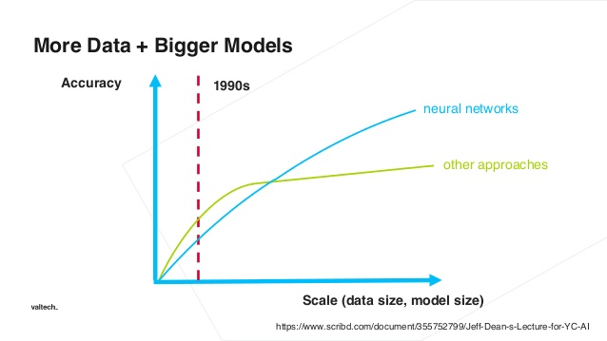



Why is deep learning taking off?

Slide 6
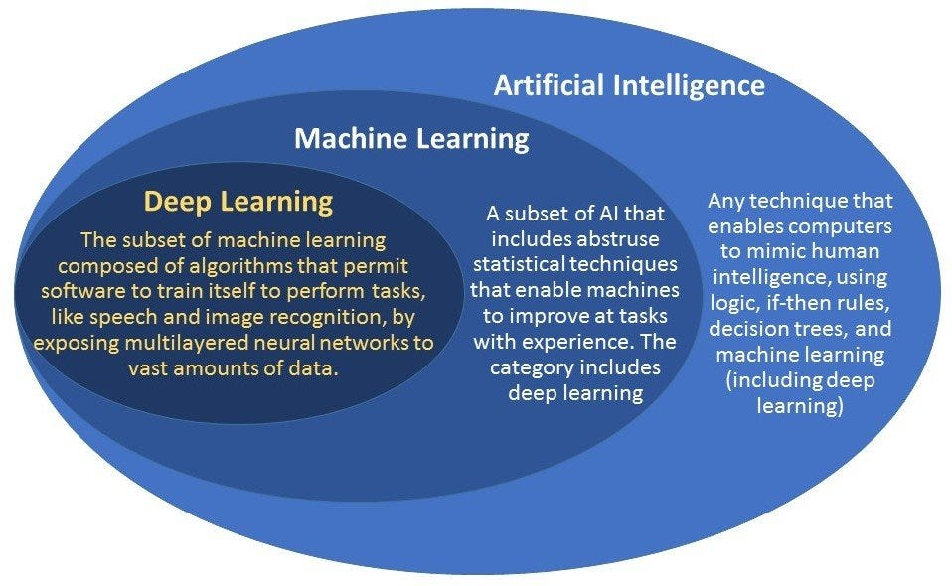
What is a nn?

Slide 7
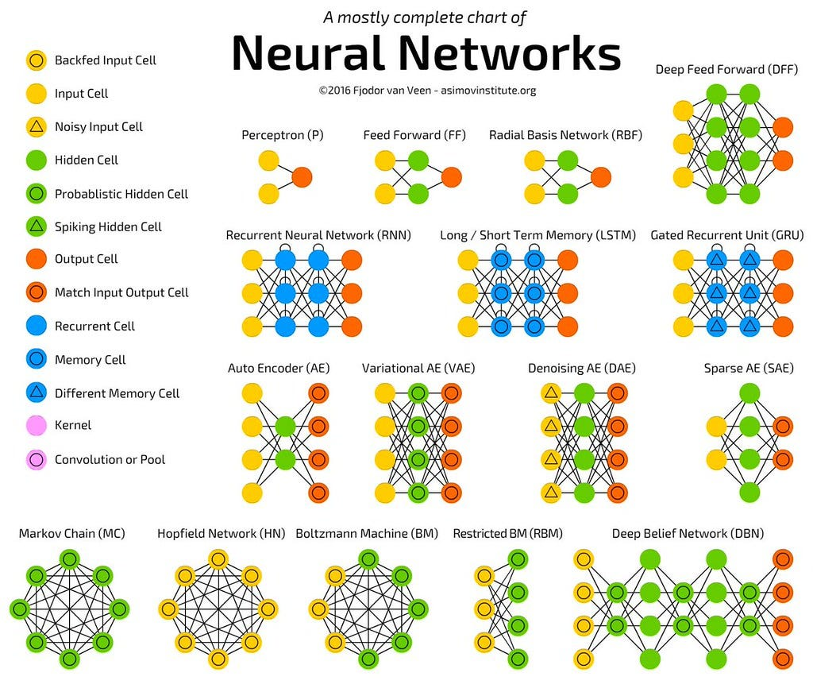
What is neural network?
Definition: A Neural Network (NN) is a group of interconnected artificial or natural neurons that uses a mathematical or computational model for data modeling or decision making.
Applications: They can be used to model complex relationships between inputs and outputs or to find patterns in data.

Slide 8
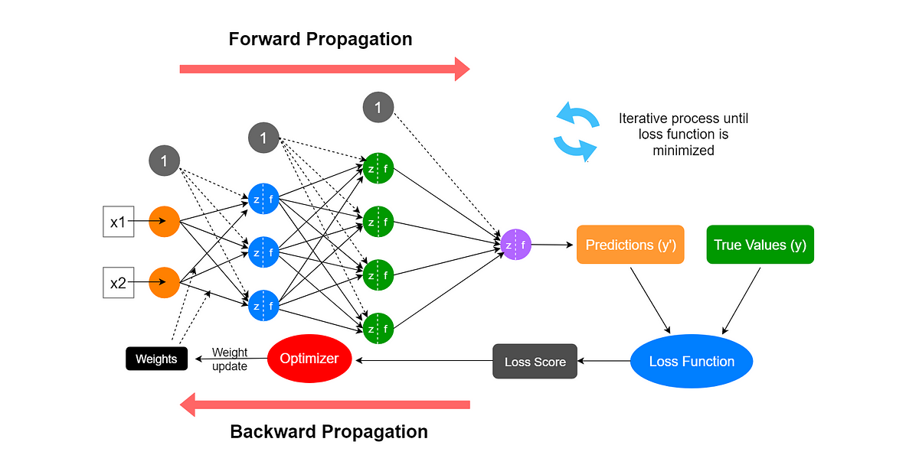
Structure and Parameters of ANNs
ANNs consist of layers of interconnected nodes (neurons). These neurons have weights that determine the strength of the connection between them.
The network’s structure remains constant (input layer, hidden layers, output layer), but the values of the weights and biases are adjustable.
Notes:
Forward Propagation: The process of passing inputs (e.g., x1x_1x1​ and x2x_2x2​) through the neural network to generate predictions.
Weights: The parameters that adjust how strongly inputs influence the neurons in each layer.
Activation Functions (f): Non-linear functions applied to the weighted inputs (e.g., ReLU or Sigmoid) to introduce non-linearity in the model.
Predictions (y′y'y′): The output generated by the neural network after forward propagation.
True Values (yyy): The actual, ground truth values that the model aims to predict.
Loss Function: A function that calculates the error between the predictions and the true values (e.g., Mean Squared Error).
Loss Score: The numerical result of the loss function, indicating how far the predictions are from the true values.
Optimizer: An algorithm (e.g., SGD or Adam) that adjusts the network's weights to minimize the loss score by computing gradients.
Backward Propagation: The process of propagating the error back through the network to update the weights, using the optimizer.
Weight Update: The adjustment of weights based on the gradients calculated during backpropagation to minimize the loss.
Iterative Process: The cycle of forward and backward propagation continues until the loss function is minimized, optimizing the model.

Slide 9
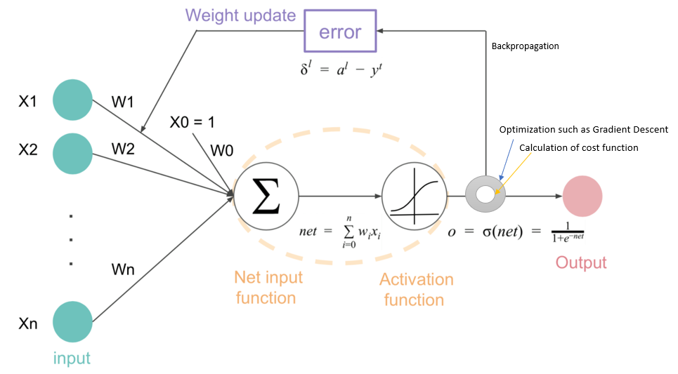
Learning Process
During the training phase, the ANN is fed data, and the system learns from this data by adjusting the weights and biases through a process called backpropagation.
This adjustment happens by minimizing the difference (error) between the network’s predicted output and the actual target output (using an optimization algorithm like gradient descent).

Slide 10
Deep( Representation) Learning

Slide 11
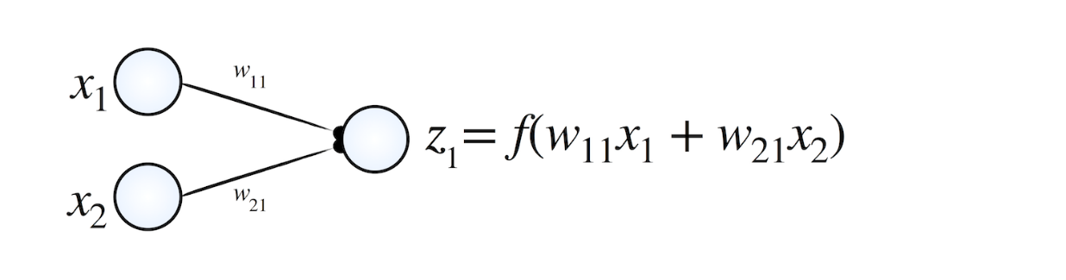
Data representation
The goal of NN is to learn 𝑓 or data representation
Function 𝑓 determines how the input data is transformed at each neuron
The way 𝑓 transforms data contributes to the decision boundaries the network “learns”.
𝑓 is responsible for transforming data into meaningful representations at each layer of the network.

Slide 12
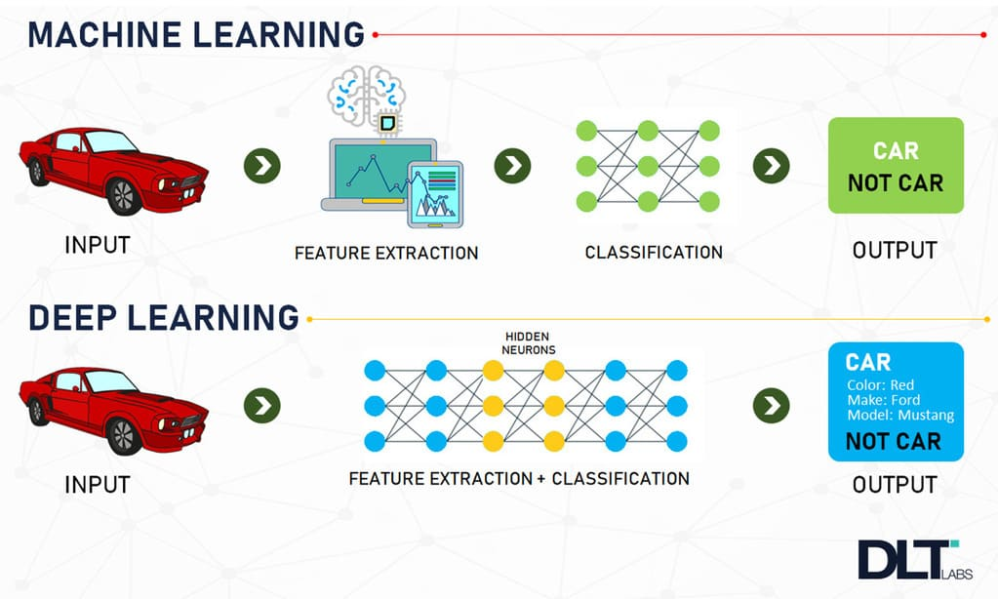
ML vs DL
In traditional machine learning, feature extraction is often done manually,
but in deep learning, the DNN (Deep Neural Network) models learn to extract numerical representations (known as feature embeddings) from raw data automatically.

Slide 13
Deep (Representation) Learning
Representation learning refers to the process where a deep learning model automatically extracts features or representations from raw input data (such as images, text, or audio) in a way that makes it easier for the model to perform a task (like classification, regression, or pattern recognition).
For example, in image recognition, the early layers of a deep neural network might learn to detect edges or shapes, while deeper layers learn to represent more abstract features like eyes or faces.
These numerical representations (or embeddings) are highly structured and useful for solving various tasks.

Slide 14
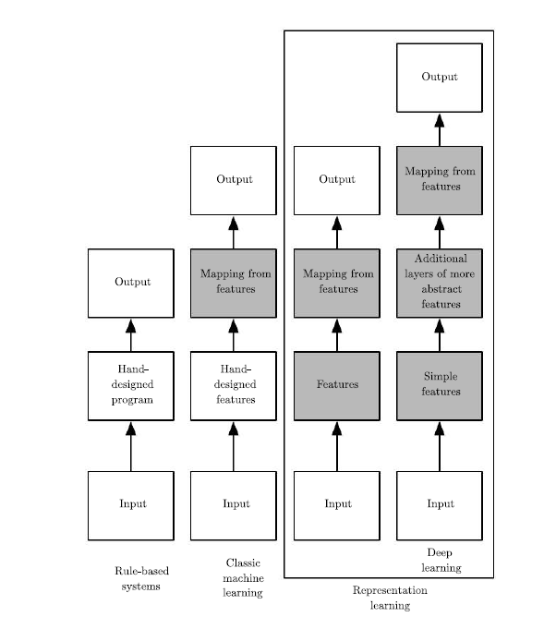
Deep Learning Definition
Deep learning is learning how to represent the data in a machine learning system

Slide 15
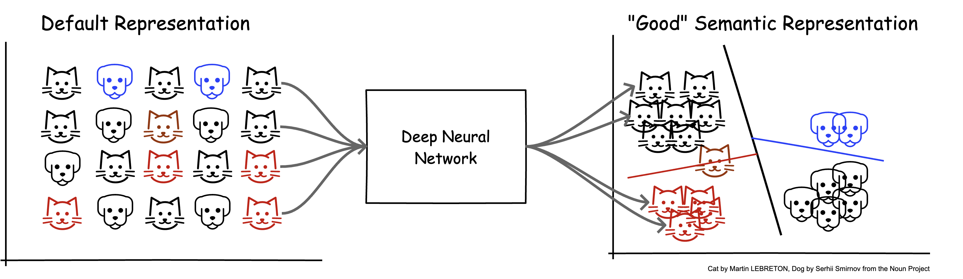
Data representations matter
Deep Neural Networks (DNNs) have become a particularly useful tool in building intelligent systems that simplify cognitive tasks for users.
The performance of many of these systems is gated on their ability to create representations (or features) of data with semantic meaning - numbers that truly encode the meaning of each data point with respect to the current task.
DNN models are the tool of choice in realizing such systems, because they excel at learning semantically meaningful representations.
Notes:
https://blog.fastforwardlabs.com/2020/11/15/representation-learning-101-for-software-engineers.html

Slide 16
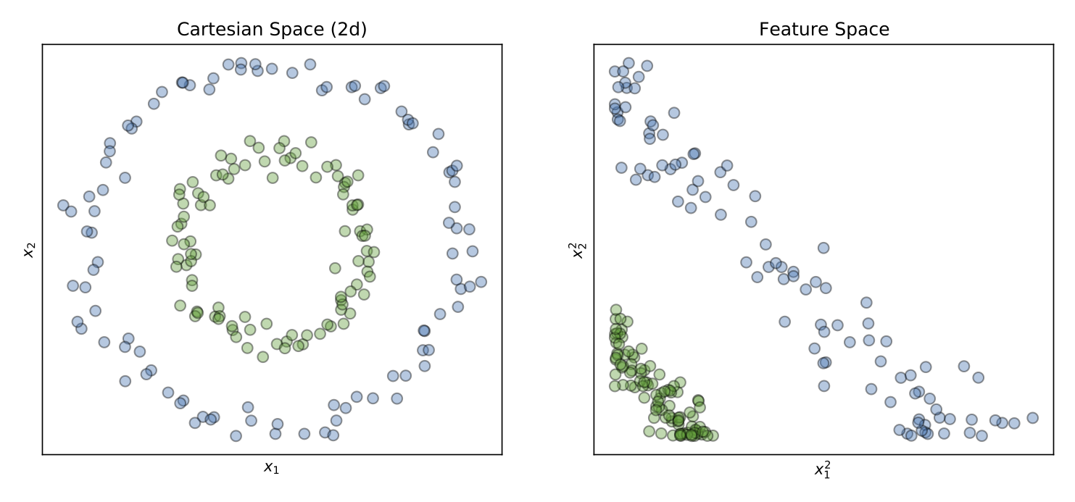
Data Representation
A simple transformation, e.g. squaring the values of the raw features, may be enough to solve the problem.

Slide 17
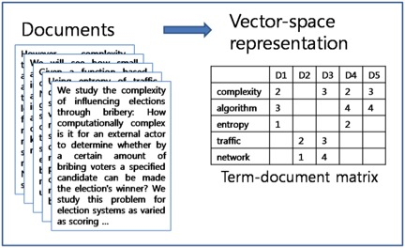
DL representation example
If we decide to build a spam email detector, passing a large body of raw, unstructured email data to the classifier will not help.
Instead, we need to find a different way to represent the text in a structured manner before feeding it to the classifier.
A commonly used representation for this type of task is the Term-Document Matrix (TDM).
The Term-Document Matrix represents the email data as a matrix where each row corresponds to a document (email) and each column corresponds to a unique word (term) from the entire collection of emails.
The entries in the matrix typically represent the frequency (or weighted frequency, such as Term Frequency-Inverse Document Frequency, or TF-IDF) of each word in each email.
By representing the text in this matrix format, the classifier can easily capture the significance of each word across different emails.
The matrix transforms the text into a numerical format that deep learning models can process.
Each entry in the matrix allows the model to evaluate how often specific words occur in each email and whether their patterns or frequencies correspond to spam characteristics.
This structured representation helps deep learning models recognize patterns in the text data, improving the accuracy of spam detection.

Slide 18
Data Representation Challenges
Data Quality and Quantity:
Deep learning models need large amounts of clean, labeled data for effective training.
Curse of Dimensionality:
High-dimensional data (like images or text) can lead to overfitting and make learning difficult.
Handling Different Types of Data:
Sequential Data (like text or time series) is particularly challenging. Models need to understand both the current input and the context from previous inputs.
For example, the meaning of a word depends on the words before it, and stock prices depend on past trends.
Deep Learning Models:
RNNs, LSTMs, and Transformers are designed to handle sequential data.
They attempt to "remember" past inputs, but struggle with long-term dependencies, making it difficult to process long sequences accurately.
Notes:
https://sthalles.github.io/a-few-words-on-representation-learning/

Slide 19
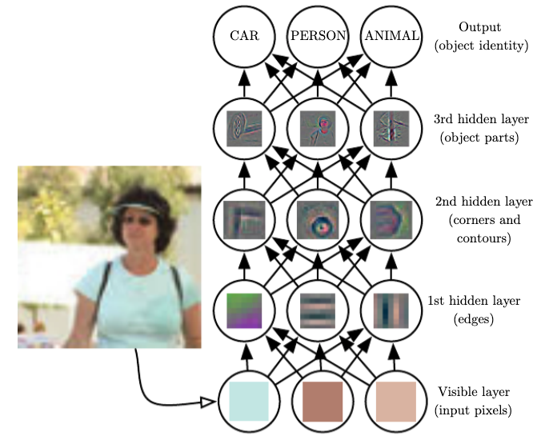
Layered Learning in DNNs
DNNs use multiple layers of neurons to progressively transform raw data into more abstract and informative representations.
Each layer learns to map data in a way that makes the final task (e.g., classification, translation, recommendation) easier.
Thus, the neurons of the first layers may learn programs that can detect edges and contours from the high-frequency input, and as the features traverse the hierarchy of layers, the subsequent neurons combine the pre-existing knowledge to learn more complex programs that can detect object parts.

Slide 20
Architecture of NN

Slide 21
A Neuron (= a perceptron)
-
t
x₀
w₀
x₁
w₁
∑
f
output y
x_{n}
w_{n}
Input
vector x
weight
vector w
weighted
sum
Activation
function
The n-dimensional input vector x is mapped into variable y by means of the scalar product and a nonlinear function mapping
Notes:
21

Slide 22
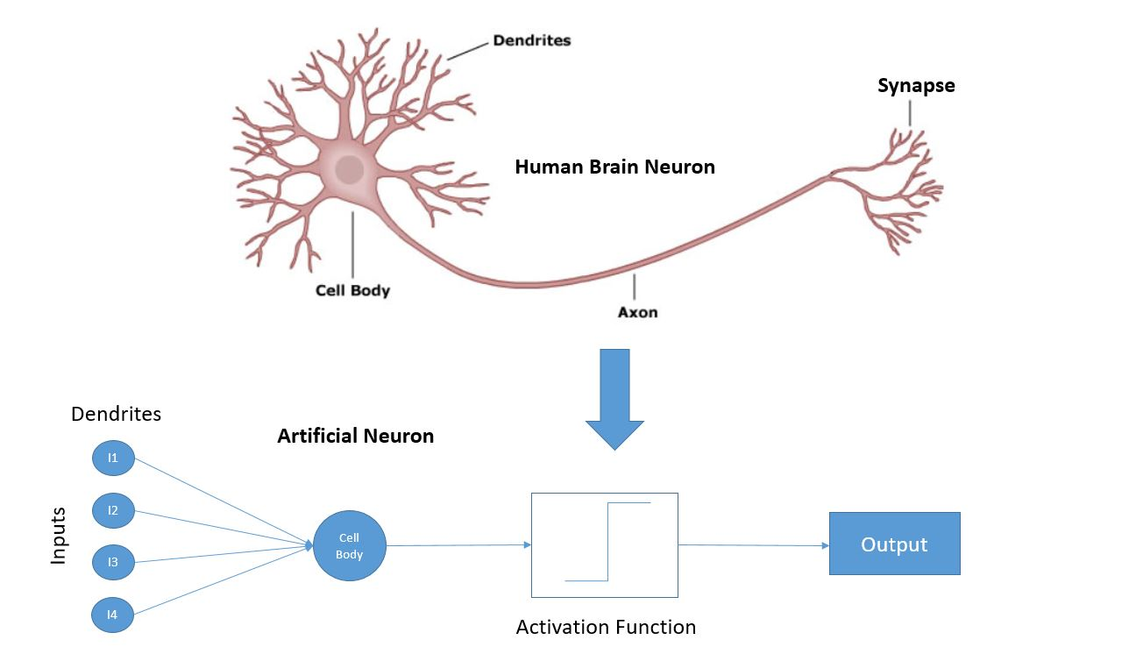
NN intuition

Slide 23
Artificial Neural Networks (ANN)
Model is an assembly of inter-connected nodes and weighted links
Output node sums up each of its input value according to the weights of its links
Compare output node against some threshold t
Perceptron Model
or
Notes:
Basic unit in a neural network
Linear separator
Parts
N inputs, x₁ ... x_{n}
Weights for each input, w₁ ... w_{n}
A bias input x₀ (constant) and associated weight w₀
Weighted sum of inputs, y = w₀x₀ + w₁x₁ + ... + w_{n}x_{n}
A threshold function or activation function,
i.e 1 if y > t, -1 if y <= t

Slide 24
Types of connectivity
Feedforward networks
These compute a series of transformations
Typically, the first layer is the input and the last layer is the output.
Recurrent networks
These have directed cycles in their connection graph. They can have complicated dynamics.
More biologically realistic.
output units
hidden units
input units

Slide 25
Different Network Topologies
Single layer feed-forward networks
Input layer projecting into the output layer
Single layer
network
Input Output
layer layer

Slide 26
Different Network Topologies
Multi-layer feed-forward networks
One or more hidden layers. Input projects only from previous layers onto a layer.
2-layer or
1-hidden layer
fully connected
network
Input Hidden Output
layer layer layer

Slide 27
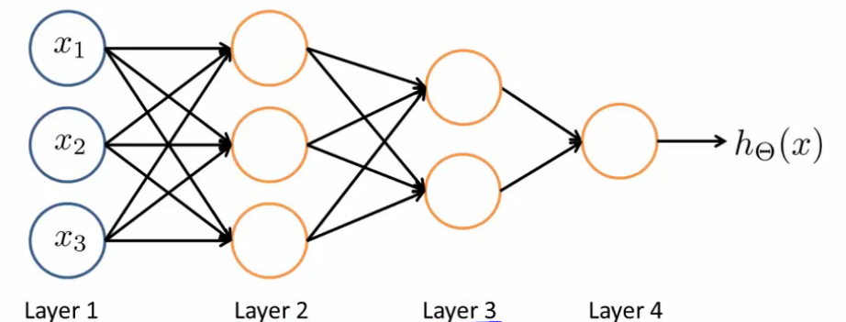
Different Network Topologies
Multi-layer feed-forward networks
Input Hidden Output
layer layers layer

Slide 28
Different Network Topologies
Recurrent networks
A network with feedback, where some of its inputs are connected to some of its outputs (discrete time).
Recurrent
network
Input Output
layer layer

Slide 29
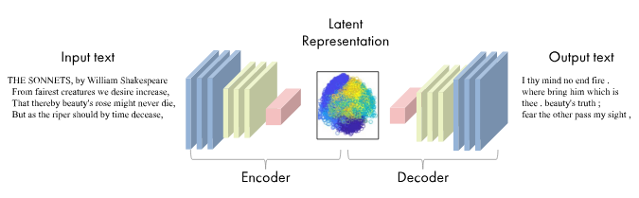
Encoder-Decoder Architecture
The Encoder processes the input and extracts meaningful features, reducing the input to a compact, informative representation (latent space).
The Decoder then takes this representation and reconstructs the output, which may be in a different format (e.g., translating text) or a transformed version of the input (e.g., reconstructing an image).

Slide 30
Computation Graphs

Slide 31
Computation Graphs in Deep Learning
A computation graph is a way to represent mathematical expressions and the flow of data in a model.
It breaks down complex computations into smaller, structured steps.
Key Components:
Nodes: Represent operations or variables (e.g., addition, multiplication, activation functions).
Edges: Show the flow of data between operations.
Inputs: Raw data (e.g., features like images, text, etc.).
Outputs: Final predictions or results from the model.

Slide 32

Computation Graph Example

Slide 33
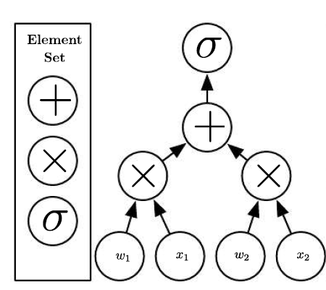
Computation Graphs
The Element Set includes three operations:
addition (+)
multiplication (×)
and the sigma (σ) symbol, which often represents an activation function (e.g., sigmoid, ReLU, etc.).
These operations are used to process inputs and weights to produce an output for the next layer of a neural network.
The flow shows the basic structure of a perceptron:
w₁ and w₂ are the weights applied to the inputs.
x₁ and x₂ are the input values.
The inputs are multiplied by their corresponding weights, and the results are summed.
The final sum is passed through an activation function (σ), which outputs the processed value.
Notes:
Example of a Simple Computation Graph:
Inputs: x1,x2x_1, x_2x1​,x2​
Weights: w1,w2w_1, w_2w1​,w2​
Operations:
Multiply each input by its weight: x1×w1x_1 \times w_1x1​×w1​, x2×w2x_2 \times w_2x2​×w2​
Sum the results: x1w1+x2w2x_1w_1 + x_2w_2x1​w1​+x2​w2​
Apply an activation function: σ(x1w1+x2w2)\sigma(x_1w_1 + x_2w_2)σ(x1​w1​+x2​w2​)

Slide 34
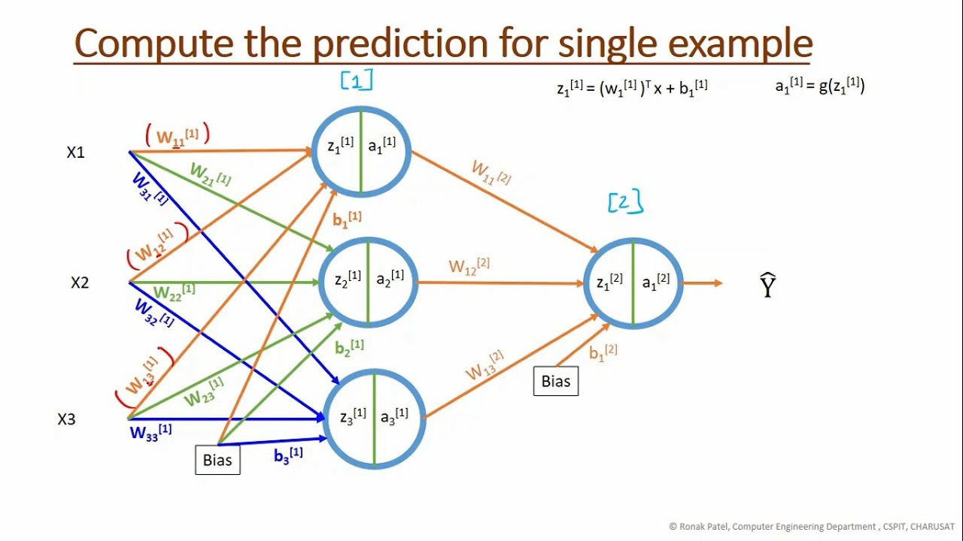
Depth in Graphs
In a computation graph, depth also refers to the sequence of operations.
For example, the graph starts from the inputs, goes through multiple computational steps (each step corresponding to a layer or an operation), and finally reaches the output.
The depth of a graph affects how the forward pass (the process of getting outputs from inputs) and backward pass (backpropagation for updating weights) are performed
If there are 3 layers (input, hidden, and output), the depth of the computation graph is 3.

Slide 35
ANN example

Slide 36
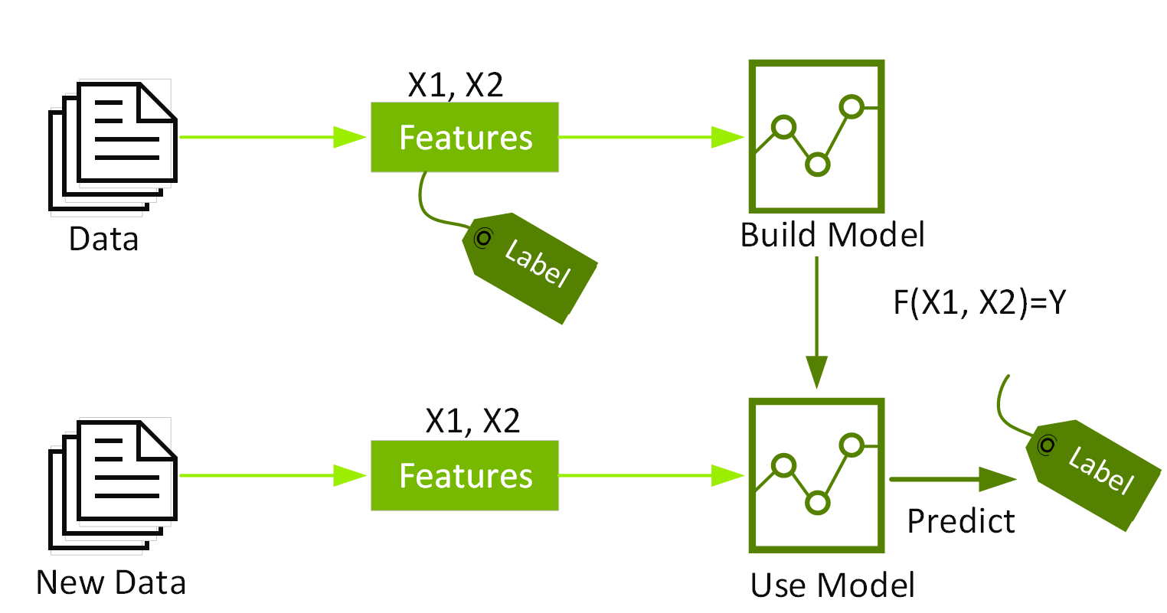
“Predictive” modelling in ML vs DL

Slide 37
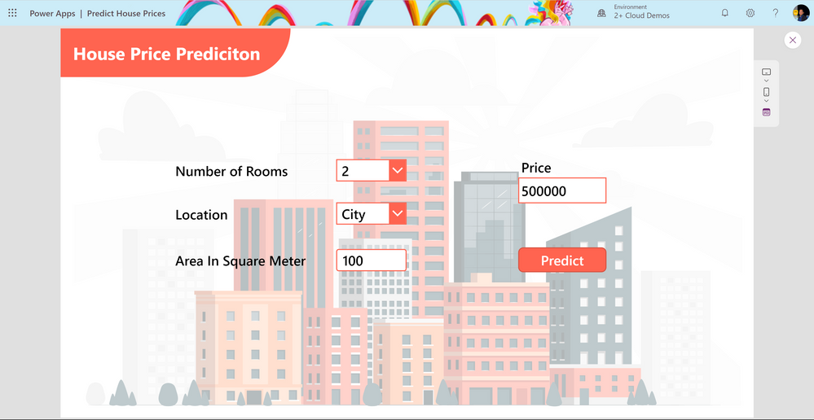
The housing price ML problem
The real estate company aims to leverage a dataset of property prices in Toronto to enhance the sale prices based on key factors like area, bedrooms, parking, etc. Specifically, the objectives are:
- Identify the factors influencing house prices, such as area, number of rooms, bathrooms, etc.
- Develop a linear model that establishes a quantitative relationship between house prices and variables like number of rooms, area, number of bathrooms, etc.
- Evaluate the model's accuracy, gauging how effectively these variables can predict house prices.

Slide 38
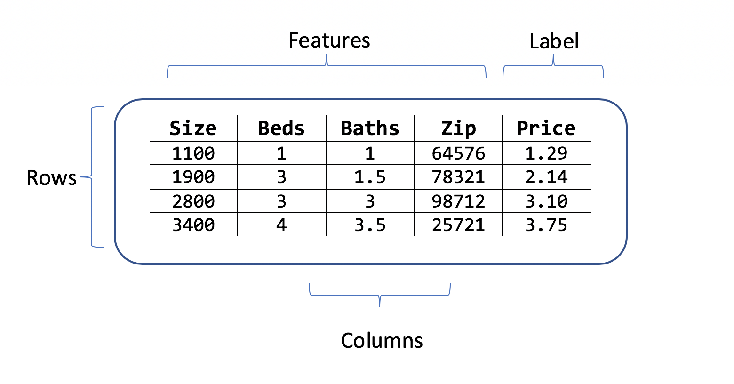
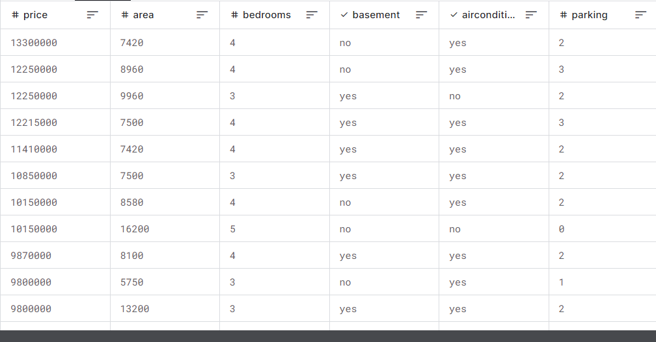
Data has “features” → predict “class” (classification) or “Value” (regression)

Slide 39
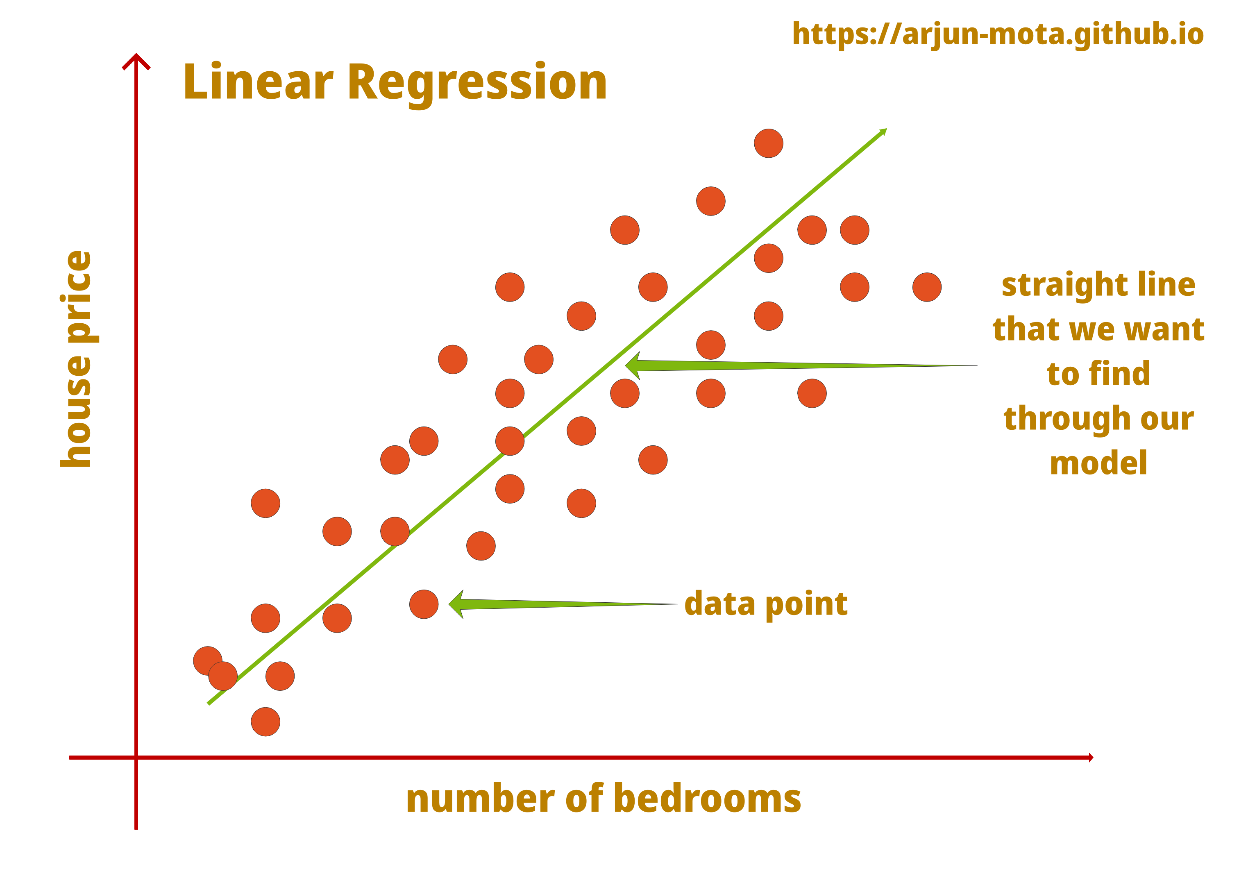
The housing price ML problem
Data Set Example: Suppose you have a data set with six houses, including the size of each house (in square feet or square meters) and its price.
You aim to predict the price of a house based on its size.
Linear Regression Approach: One might start with a linear regression model, fitting a straight line to the data. However, since prices cannot be negative, a straight line may not be ideal as it might eventually predict negative prices for smaller house sizes.

Slide 40

UW machine learning house prediction video

Slide 41
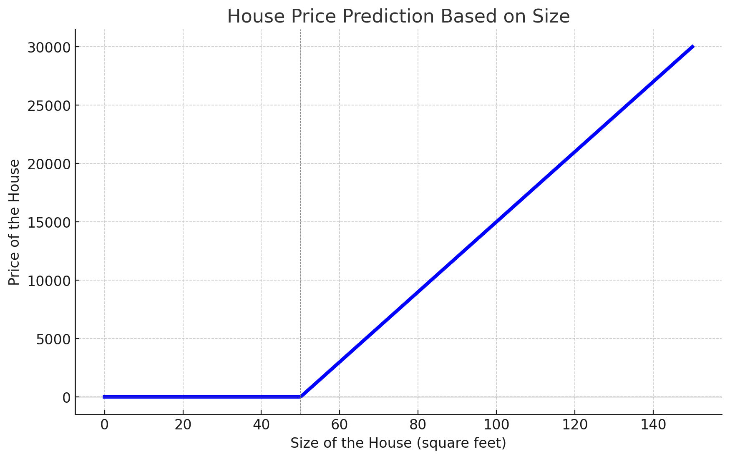
Non-Negative Price Constraint
To address this, you can modify the model to ensure prices never go negative by bending the curve.
The function predicts zero for very small sizes and then follows a straight line for larger sizes.
This thick blue line becomes your function for predicting house prices based on size.
This blue line is called a “ReLu” function

Slide 42
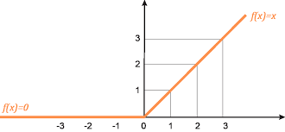
ReLU Function
ReLU i.e. rectified linear unit, is a non-linear activation function used for deep neural networks in machine learning. It is also known as the rectifier activation function.
Definition: f(x)=max⁡(0,x)
Explanation:
For x<0, f(x)=0
For x≥0 f(x)= x
The graph visually demonstrates these properties:
The function outputs zero for any input less than zero.
The function outputs the input value itself for any input greater than or equal to zero.

Slide 43
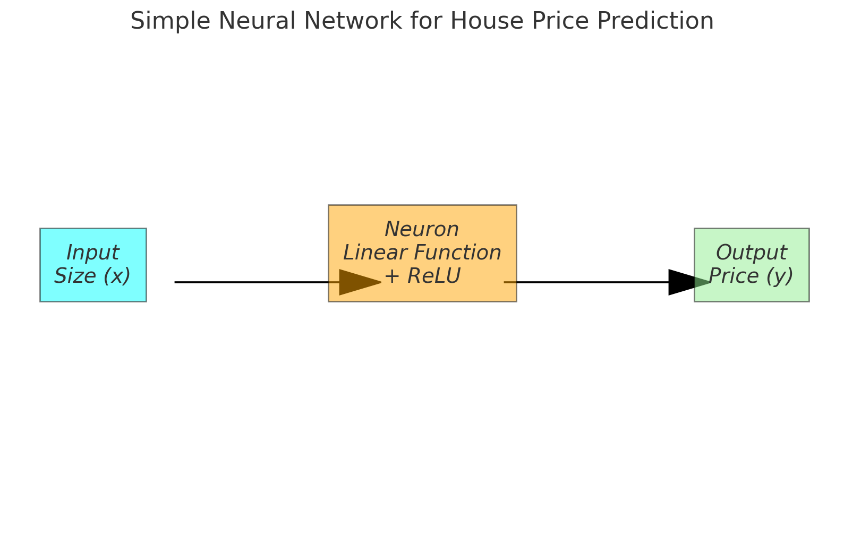
Simple Neural Network
Simple Neural Network Representation: This function can be visualized as a very simple neural network.
Input: The size of the house (𝑥x).
Neuron: A single neuron that applies a linear function and then a ReLU activation.
Output: The predicted price of the house (𝑦).
This simple neural network effectively implements the function drawn earlier to predict house prices.

Slide 44
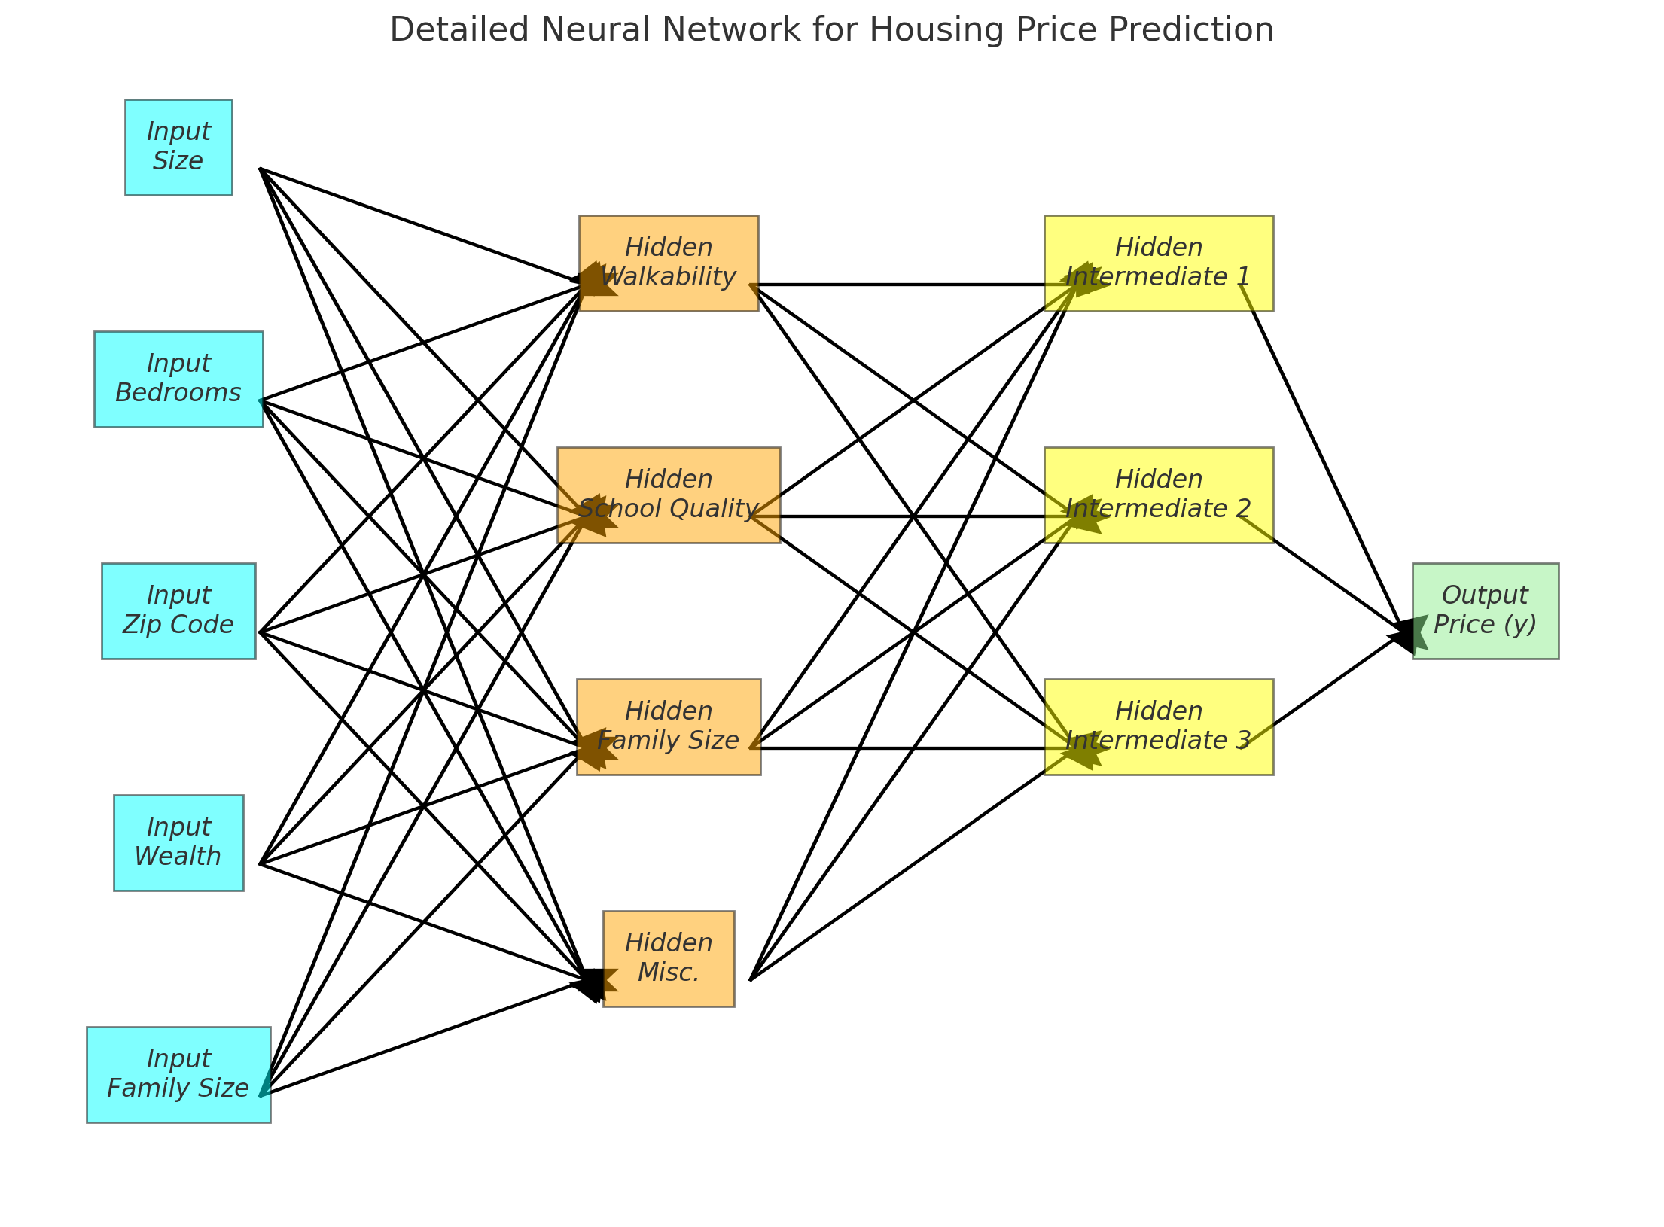
Larger NN
Input Features:
Size: The size of the house.
Bedrooms: The number of bedrooms.
Zip Code: The postal code of the house.
Wealth: The wealth of the neighborhood.
Family Size: The size of the family the house can accommodate.
Hidden Layers:
First Hidden Layer:
Walkability: Evaluates the walkability of the neighborhood.
School Quality: Assesses the quality of nearby schools.
Family Size: Determines the suitability of the house for different family sizes.
Miscellaneous: Other relevant factors.
Second Hidden Layer:
Intermediate Nodes: Further processing and integration of features from the first hidden layer.
Output:
Price (y): The predicted price of the house.

Slide 45
Feature | Description | First Hidden Layer Calculations | First Hidden Layer Activation | Second Hidden Layer Calculations | Second Hidden Layer Activation | Output Calculation | Output
Size | The size of the house in square feet or square meters. | Input * Weight1 + Bias1 | ReLU(Output1) | Hidden1 * Weight6 + Hidden2 * Weight7 + Hidden3 * Weight8 + Hidden4 * Weight9 | ReLU(Output6) | Hidden5 * Weight26 + Hidden6 * Weight27 + Hidden7 * Weight28 + Hidden8 * Weight29 + Hidden9 * Weight30 | Predicted Price (y)
Bedrooms | The number of bedrooms in the house. | Input * Weight2 + Bias2 | ReLU(Output2) | Hidden1 * Weight10 + Hidden2 * Weight11 + Hidden3 * Weight12 + Hidden4 * Weight13 | ReLU(Output7)
Zip Code | The postal code indicating the house's location. | Input * Weight3 + Bias3 | ReLU(Output3) | Hidden1 * Weight14 + Hidden2 * Weight15 + Hidden3 * Weight16 + Hidden4 * Weight17 | ReLU(Output8)
Wealth | The wealth level of the neighborhood. | Input * Weight4 + Bias4 | ReLU(Output4) | Hidden1 * Weight18 + Hidden2 * Weight19 + Hidden3 * Weight20 + Hidden4 * Weight21 | ReLU(Output9)
Family Size | The size of the family the house can accommodate. | Input * Weight5 + Bias5 | ReLU(Output5) | Hidden1 * Weight22 + Hidden2 * Weight23 + Hidden3 * Weight24 + Hidden4 * Weight25 | ReLU(Output10)

Slide 46
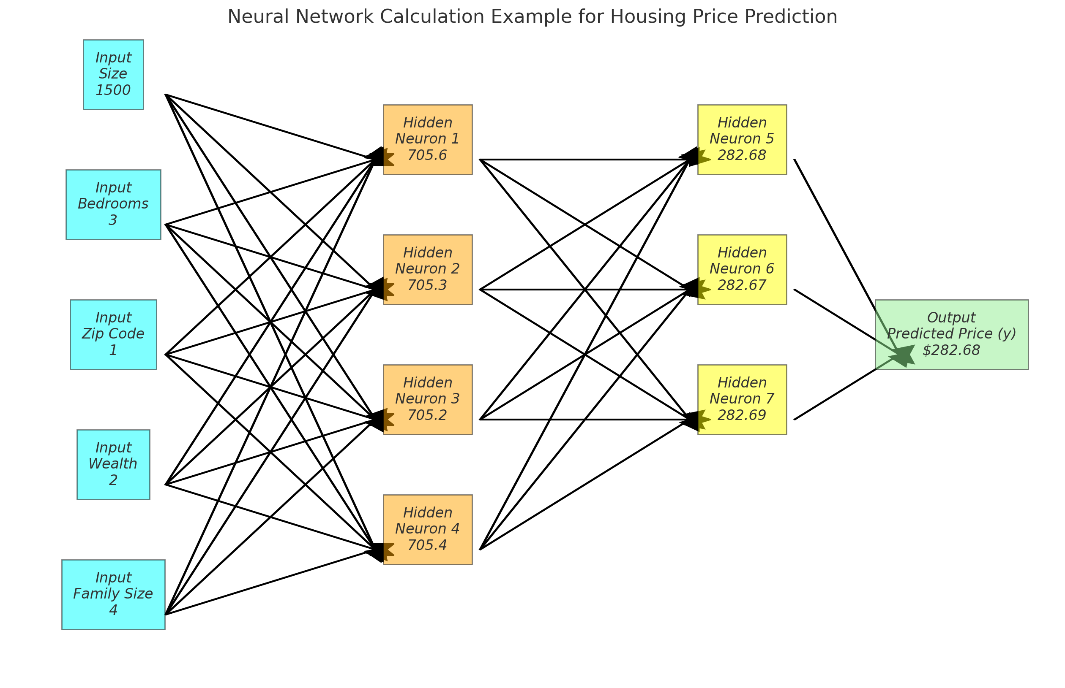

Slide 47
Questions

